Slide 1
GROUP MEMBERS
Muneeza Badar (CR-22022)
Syed Gufran Raza (CR-22028)
Muhaib Shamsher (CR-22029)

Slide 2
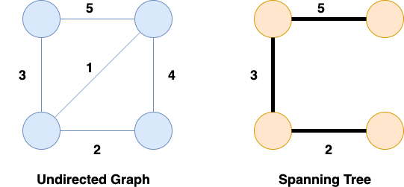

SPANNING TREE
Spanning Tree is a subset of an undirected and connected graph in which all the nodes of the graph are connected with each other with the help of (n-1) edges where n is the number of nodes or vertices present in the graph G.

Slide 3
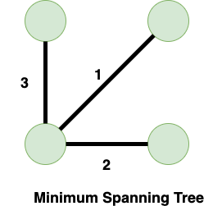
MINIMUM SPANNING TREE
Minimum Spanning Tree is that Spanning Tree whose cost is the least among all the possible Spanning Trees. The cost of a Spanning Tree is the sum of the weight of all the edges that are present in that Spanning Tree .
There are two algorithms of MST
Prim’s Algorithm
Kruskal’s Algorithm

Slide 4
Prim’s Algorithm
Prim's Algorithm uses a greedy approach to build a minimum spanning tree by starting from an initial node and adding the shortest edge that connects a new vertex to the tree.
Start by selecting any vertex as the starting point for the Minimum Spanning Tree (MST).
Look at all edges connecting the vertices already in the MST to those not yet included, and choose the edge with the smallest weight.
Add the vertex connected by the chosen edge to the MST.
Repeat steps 2 and 3 until all vertices are included in the MST.

Slide 5
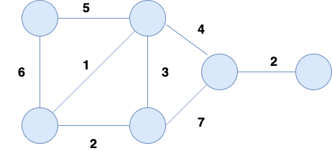
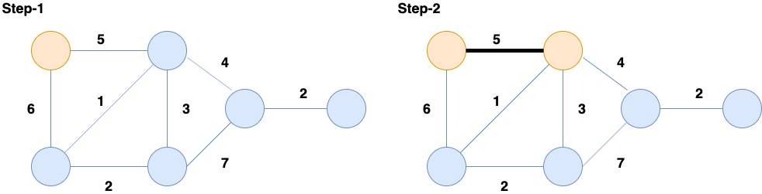
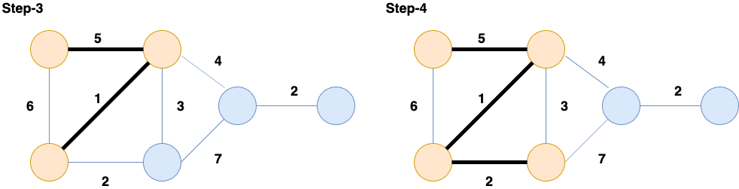
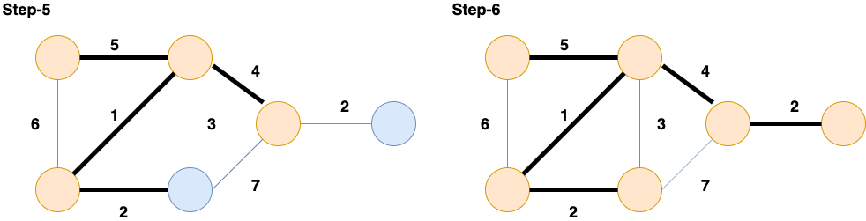

Slide 6
Kruskal’s Algorithm
we make a list of edges that are sorted on the basis of their cost and after that, we take the smallest edge one by one. The following steps are involved in Kruskal's Algorithm:
Sort the edges of the graph based on their cost.
Add the edge having the least cost until all vertices are connected.
Add only those edges which are not forming any cycles.

Slide 7

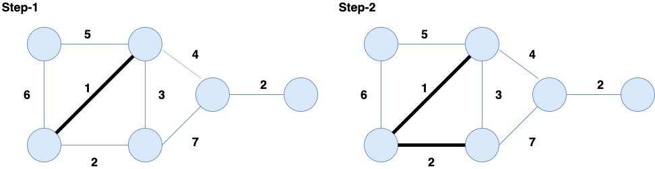
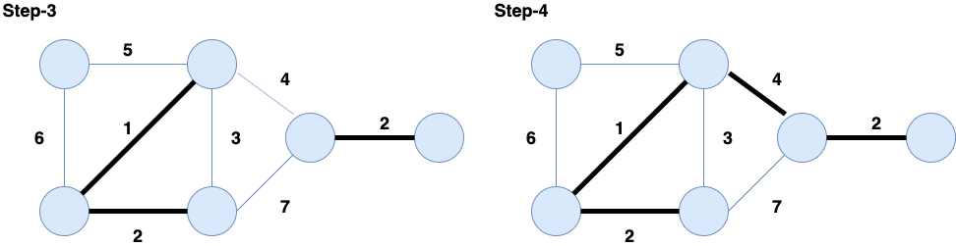
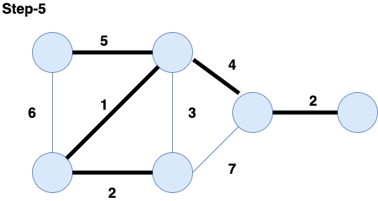

Slide 8
Complexity
Prim’s
Selecting Minimum Vertex: This takes O(V) in each of the V−1 iterations, contributing O(V^2) in total.
Updating Adjacent Vertices: The inner loop also takes O(V) in each iteration, contributing another O(V^2).
So. The complexity is O(V^2)
Kruskal’s
1. Sorting the Edges: Sorting the ( E ) edges takes O(E log E) .
2. Union by Rank and Path Compression: Checking each edge for the MST using DSU (find and union) operations takes O(log V) per edge, totaling O(E log V) for all edges.
3. Total Time Complexity: T(n) = O(E log E) + O(E log V) .
4. Simplified for Dense Graphs: For dense graphs, O(E log E) approx O(E log V) .
Final Complexity: Kruskal's algorithm has a time complexity of O(E log V) or O(E log E) .

Slide 9
AquaConnect: Efficient Water Distribution with MST Algorithm
A water pipeline network for a residential society, represented as a collection of houses on a 2D plane. Each house is a unique point on this plane, defined by its coordinates. The goal is to construct a water pipeline system that connects all the houses with the minimum possible cost. The cost to lay a pipeline between two houses is based on the Manhattan distance between them, calculated as:
Cost=∣x1−x2∣+∣y1−y2∣
To achieve this, we need to determine the Minimum Spanning Tree (MST) for the network, which will connect all houses with the least total pipeline cost, ensuring that the water reaches every house without any redundant connections.

Slide 10
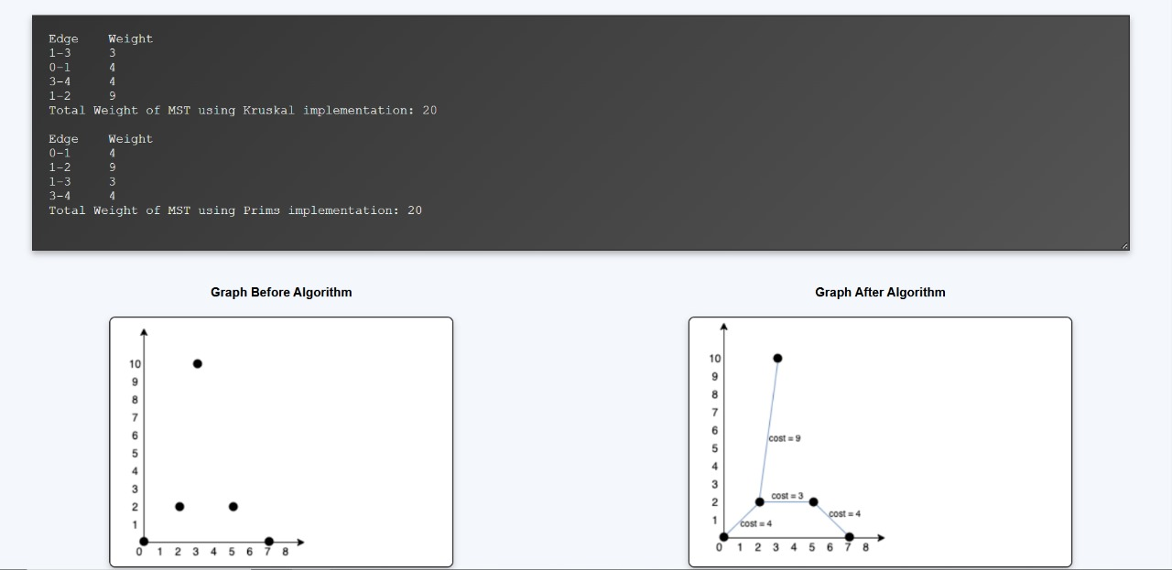

Slide 11
Comparison
Prim’s
Kruskal’s
This algorithm begins to construct the shortest spanning tree from any vertex in the graph.
To obtain the minimum distance, it traverses one node more than one time.
The time complexity of Prim’s algorithm is O(V^2).
In Prim’s algorithm, all the graph elements must be connected.
When it comes to dense graphs, the Prim’s algorithm runs faster.
This algorithm begins to construct the shortest spanning tree from the vertex having the lowest weight in the graph.
It crosses one node only one time.
The time complexity of Kruskal’s algorithm is O(E log V).
Kruskal’s algorithm may have disconnected graphs.
When it comes to sparse graphs, Kruskal’s algorithm runs faster.

Slide 12
Applications
Applications of Prim's Algorithm:
1. Network Design: Connects nodes in telecom and computer networks with minimal cost, avoiding loops.
2. Transportation: Optimizes road network layouts for minimal distance.
3. Cluster Analysis: Identifies data clusters by minimizing connections.
4. Infrastructure: Connects endpoints in pipelines and railroads with minimal resources.
Applications of Kruskal's Algorithm:
1. Network Design: Effective for sparse networks with fewer edges.
2. Social Networking: Forms clusters by linking closely connected users.
3. Image Segmentation: Segments images by minimizing pixel difference.
4. Electric Grid Layouts: Minimizes costs for connecting substations without loops.
5. GPS: Aids in route planning by mapping minimal distances between locations.

Slide 13
THANK YOU!

